Slide 1
Engineering and Operations Management Lunch & Learn Webinar Series
November 11, 2020

Slide 2
Please save all questions until the end of the presentation.
Please do not use the “Raise Hand” feature in this session.
We ask all questions will be typed in the Chat Box at the end of the presentation.
THANK YOU!
LET’S GET STARTED!
Notes:
Slide

Slide 3

College of Engineering & Industrial Engineering Programs
Master of Science
Operations Management
Engineering Management
Engineering
Graduate Certificates
Project Management
Lean Six Sigma
Homeland Security

Slide 4

Today’s Presenter
Walt DeGrange
Sports Analytics: Putting the Fun Back Into Analytics
Walt DeGrange is the Director for Analytics Capability for CANA Advisors where he helps organizations use analytics across federal and commercial domains. Prior to CANA Advisors, he had 21 years of Naval service as a Supply Corps Officer. The last 10 years in the Navy, his positions focused on supply chain analytics. He has taught courses in the MSOM program since 2014. Prior to that, he was an Assistant Military Professor at the Naval Postgraduate School in the Operations Research Department. Walt has also served on the Military Operations Research Society (MORS) Board of Directors and as the Chairperson for the INFORMS SpORts Section.

Slide 5
Charles Barkley (2015)
"Analytics don't work at all. It's just some crap that people who were really smart made up to try to get in the game because they had no talent. Because they had no talent to be able to play, so smart guys wanted to fit in, so they made up a term called analytics. Analytics don't work.”

Slide 6
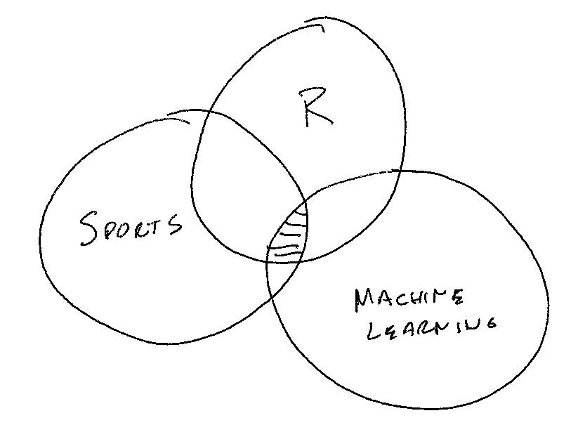
Why do this project?

Slide 7
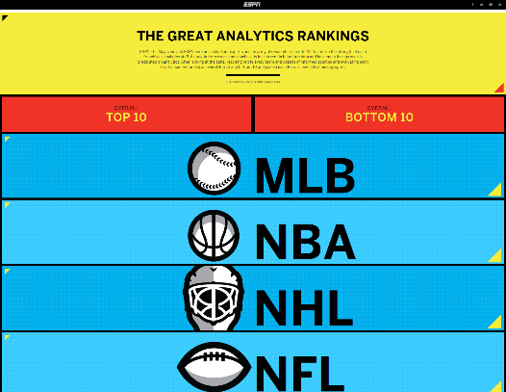
ESPN The Great Analytics Rankings (2015)
http://www.espn.com/espn/feature/story/_/id/12331388/the-great-analytics-rankings

Slide 8
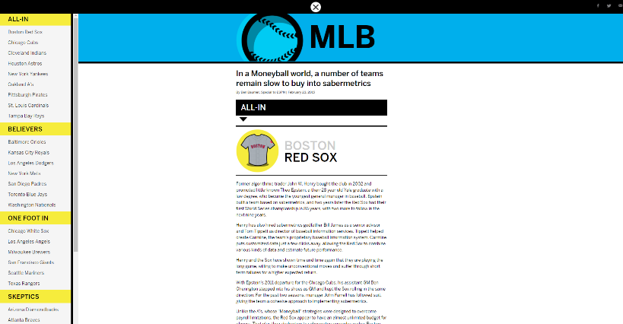
ESPN The Great Analytics Rankings (2015)
http://www.espn.com/espn/feature/story/_/id/12331388/the-great-analytics-rankings

Slide 9
Data
ESPN Analytics Ranking (1-5)
5 – All-in
4 – Believers
3 – One foot in
2 – Skeptics
1 - Nonbelievers
How far did the team go in the playoffs? (1-5)
5 – Champion
4 – Runner up
3 – Loss in third round
2 – Loss in second round
1 – Loss in first round
City size
2010 US Census
Canadian Cities Wikipedia
Salary – spotrac.com

Slide 10
Challenges
Team analytics have changed. 2015 ESPN ranking only performed once.
Salary data issues
Use available cap space for NHL, NFL, NBA
Use total team salary for MLB
Expansion
Las Vegas Golden Knights
Moving
2016 Rams - St. Louis to Los Angeles
2017 Chargers - San Diego to Los Angeles
2020 Raiders - Oakland to Las Vegas
Name Change
Washington Football Team
2020 US Census

Slide 11
Champions 2019
Sport | Team | City | ESPNRating | PopulationMil
MLB | Dodgers | Los Angeles | 4 | 3.8
NBA | Bucks | Milwaukee | 3 | 0.6
NFL | Buccaneers | Tampa Bay | 3 | 0.3
NHL | Lightning | Tampa Bay | 4 | 0.3

Slide 12
ESPN Rating
ESPNRating | Count | HowFar | MeanPop | MeanSalary
1 | 10 | 0.4 | 4.3 | 17.6
2 | 27 | 0.7 | 1.8 | 17.3
3 | 34 | 0.7 | 0.9 | 16.5
4 | 37 | 1.3 | 1.7 | 13.9
5 | 15 | 1.3 | 1.7 | 14.7

Slide 13
ESPN Ranking Best Performance
Sport | Team | City | ESPNRating | PopulationMil | HowFar
NBA | GSWarriors | Oakland | 4 | 0.4 | 3.285714
NFL | Patriots | Boston | 4 | 0.6 | 3.285714
MLB | Dodgers | Los Angeles | 4 | 3.8 | 3.142857
NHL | Lightning | Tampa Bay | 4 | 0.3 | 3.000000
NHL | Golden Knights | Las Vegas | 5 | 0.6 | 2.666667
NBA | Cavaliers | Cleveland | 4 | 0.4 | 2.428571
NFL | Chiefs | Kansas City | 4 | 2.2 | 2.428571
MLB | Astros | Houston | 5 | 2.1 | 2.428571
NHL | Penguins | Pittsburgh | 4 | 0.3 | 2.142857
NBA | Raptors | Toronto | 3 | 2.7 | 2.142857

Slide 14
ESPN Ranking Worst Performance
Sport | Team | City | ESPNRating | PopulationMil | HowFar
MLB | Pirates | Pittsburgh | 5 | 0.3 | 0.2857143
NBA | Mavericks | Dallas | 5 | 1.2 | 0.5714286
MLB | As | Oakland | 5 | 0.4 | 0.7142857
MLB | Rays | Tampa Bay | 5 | 0.3 | 0.8571429
NBA | 76ers | Philadelphia | 5 | 1.6 | 1.0000000
NBA | Spurs | San Antonio | 5 | 1.5 | 1.1428571
NHL | Blackhawks | Chicago | 5 | 2.7 | 1.1428571
MLB | RedSox | Boston | 5 | 0.6 | 1.2857143
MLB | Gardians | Cleveland | 5 | 0.4 | 1.2857143
MLB | Yankees | New York | 5 | 8.6 | 1.5714286

Slide 15
Los Angeles Team Performance
Sport | Team | ESPN | HowFar
MLB | Angels | 3 | 0.2857143
MLB | Dodgers | 4 | 3.1428571
NBA | Clippers | 2 | 1.4285714
NBA | Lakers | 1 | 0.8571429
NFL | Chargers | 1 | 0.2857143
NFL | Rams | 2 | 1.0000000
NHL | Ducks | 2 | 1.1428571
NHL | Kings | 4 | 0.2857143

Slide 16
New York Team Performance
Sport | Team | ESPN | HowFar
MLB | Mets | 4 | 0.7142857
MLB | Yankees | 5 | 1.5714286
NBA | Knicks | 1 | 0.2857143
NBA | Nets | 1 | 0.5714286
NFL | Giants | 2 | 1.1428571
NFL | Jets | 1 | 1.0000000
NHL | Islanders | 4 | 1.5714286
NHL | Rangers | 2 | 1.4285714

Slide 17
Small City's Team Performance
Sport | Team | ESPN | HowFar | PopulationMil
NFL | Packers | 3 | 2.000000 | 0.1
NHL | Panthers | 3 | 1.285714 | 0.1

Slide 18
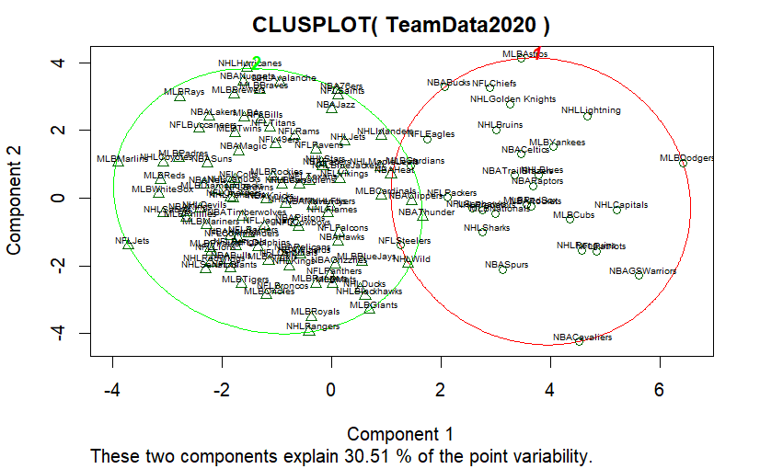
2020 K-Means Clustering Plot

Slide 19
2020 K-Means Clustering Data
Cluster | Teams | MeanX2014HF | MeanX2015HF | MeanX2016HF | MeanX2017HF | MeanX2018HF | MeanX2019HF | MeanX2020HF | MeanPopulation | MeanSalary | MeanESPNRating
1 | 94 | 0.8 | 0.6 | 0.5 | 0.4 | 0.5 | 0.7 | 0.9 | 1.7 | 17.3 | 2.9
2 | 29 | 1.5 | 1.9 | 2.3 | 2.5 | 2.2 | 1.7 | 1.4 | 1.7 | 11.2 | 4.0

Slide 20

https://github.com/ltwalt/espnsports

Slide 21


Question and Answer with Walt Type your questions in the chat section of this session.

Slide 22
M.S. Operations Management at a glance:
100% Online (or live)
In-State Tuition for Everyone!
10 Graduate Course Program (30 hours)
Up to 4 prerequisite classes may be required
Five 8-week Sessions Per Year
Pair Master’s with Graduate Certificate with no extra hours required
No GRE/GMAT required with 3.0 Bachelor's GPA
Total Program Cost is $12,000 to $15,000 (depending on prereqs needed)

Slide 23



Graduate Certificates
Project Management – Designed to provide skills to become better project managers and prepare for PMP Certification
Lean Six Sigma – Learn how to eliminate problems, remove waste and reduce variation to improve operations
Homeland Security – Designed for industry and safety professionals to learn how to mitigate risk

Slide 24

Graduate Certificates
Only 4 Classes!
Obtain as part of your Master’s Degree without taking extra classes
2.5 Undergraduate GPA required for admission
No GRE/GMAT
Classes will double count!
Can also be completed as stand-alone program
Transition to MSOM option with no GRE

Slide 25
Covid-19 Special Announcement:
Effective for Spring, Summer & Fall 2021 terms, at this time we are waiving the GRE for applicants with a 2.5-2.99 undergraduate GPA. Applicants with above a 3.0 GPA is automatically waived for any term.
Once GRE testing centers resume operations, the standard admissions requirements will go back into full effect.

Slide 26
Question and Answer with Walt Type your questions in the chat section of this session.

Slide 27
Next Webinar:
Agile Project Management & Innovative Technology Development
Presented by: Dr. Rocky Gay
Thanks for attending!
For information about our flexible degree program options, email Karin Hickenbotham kahicken@uark.edu or visit operations-management.uark.edu
Registered participants will receive an email with the video link to this webinar.
We hope to see you online next month!

Slide 28
Overview By Sport
Sport | count | MeanESPN | StdESPN
MLB | 30 | 3.5 | 1.3
NBA | 30 | 3.1 | 1.2
NFL | 32 | 2.7 | 1.0
NHL | 31 | 3.4 | 0.9

Slide 29
Local Teams
Sport | City | Team | ESPN | HowFar
MLB | Dallas | Rangers | 3 | 1.4285714
NBA | Dallas | Mavericks | 5 | 0.5714286
NFL | Dallas | Cowboys | 4 | 0.8571429
NHL | Dallas | Stars | 3 | 1.1428571
MLB | Kansas City | Royals | 4 | 1.2857143
NFL | Kansas City | Chiefs | 4 | 2.4285714
NBA | Memphis | Grizzlies | 4 | 0.5714286

Slide 30
Champions 2014
Sport | Team | City | ESPNRating | PopulationMil
MLB | Giants | San Francisco | 3 | 0.9
NBA | GSWarriors | Oakland | 4 | 0.4
NFL | Patriots | Boston | 4 | 0.6
NHL | Blackhawks | Chicago | 5 | 2.7

Slide 31
Champions 2015
Sport | Team | City | ESPNRating | PopulationMil
MLB | Royals | Kansas City | 4 | 2.2
NBA | Cavaliers | Cleveland | 4 | 0.4
NFL | Broncos | Denver | 2 | 0.6
NHL | Penguins | Pittsburgh | 4 | 0.3

Slide 32
Champions 2016
Sport | Team | City | ESPNRating | PopulationMil
MLB | Cubs | Chicago | 5 | 2.7
NBA | GSWarriors | Oakland | 4 | 0.4
NFL | Patriots | Boston | 4 | 0.6
NHL | Penguins | Pittsburgh | 4 | 0.3

Slide 33
Champions 2017
Sport | Team | City | ESPNRating | PopulationMil
MLB | Astros | Houston | 5 | 2.1
NBA | GSWarriors | Oakland | 4 | 0.4
NFL | Eagles | Philadelphia | 4 | 1.6
NHL | Capitals | Washington | 4 | 6.1

Slide 34
Champions 2018
Sport | Team | City | ESPNRating | PopulationMil
MLB | RedSox | Boston | 5 | 0.6
NBA | Raptors | Toronto | 3 | 2.7
NFL | Patriots | Boston | 4 | 0.6
NHL | Blues | St Louis | 4 | 0.3

Slide 35
Champions 2019
Sport | Team | City | ESPNRating | PopulationMil
MLB | Nationals | Washington | 4 | 6.1
NBA | Lakers | Los Angeles | 1 | 3.8
NFL | Chiefs | Kansas City | 4 | 2.2
NHL | Lightning | Tampa Bay | 4 | 0.3

Slide 36
